Slide 1










APPEARANCE
ALP

Slide 2







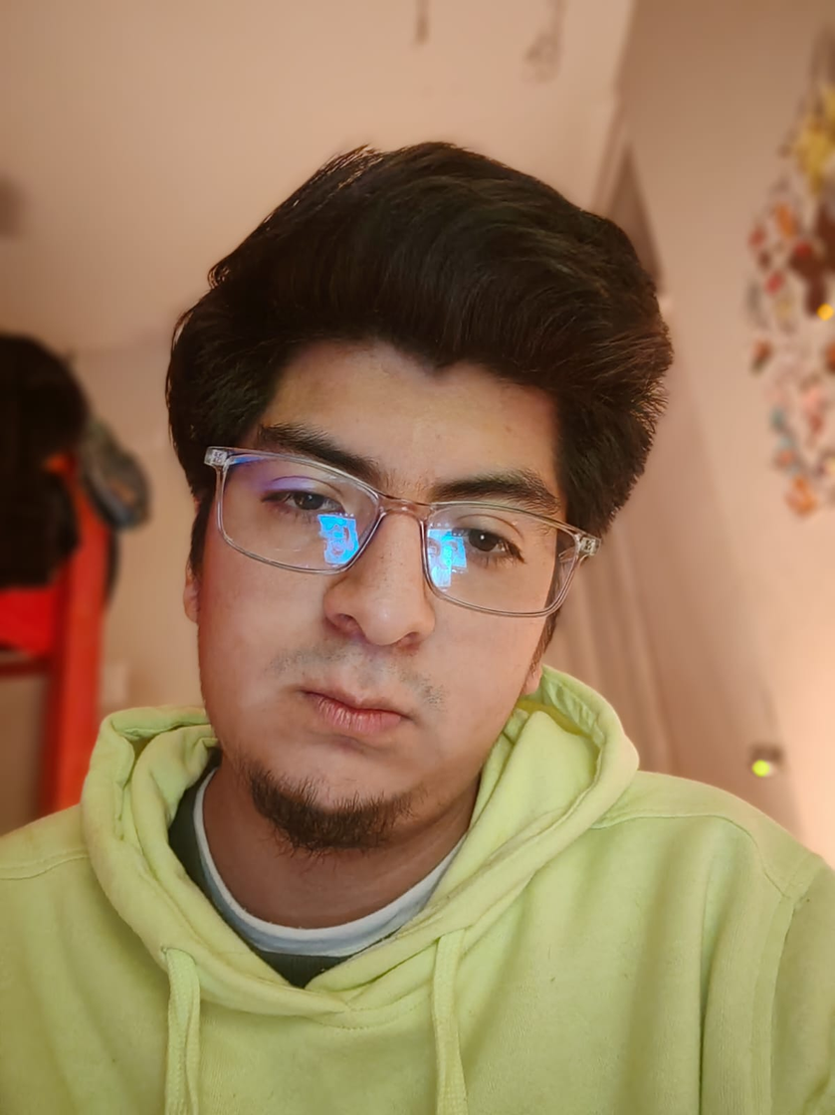



MY PRESENTATION

Slide 3
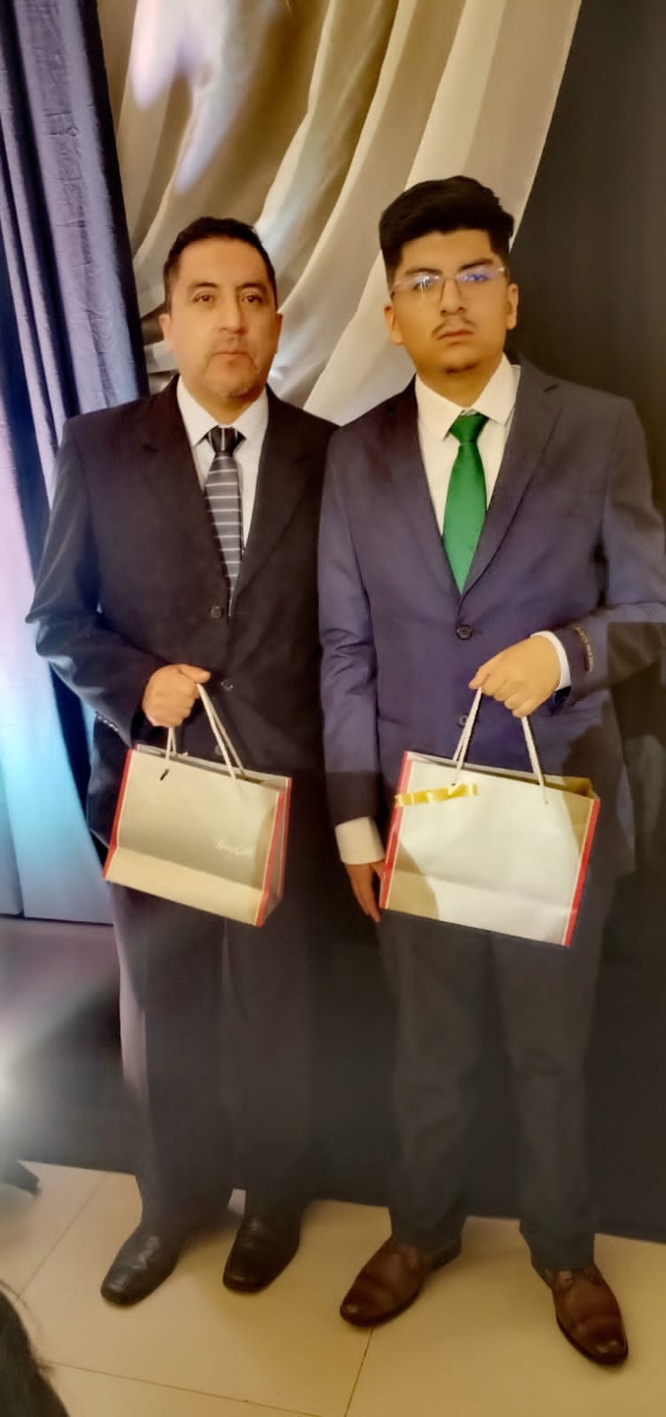

MY UNCLE

Slide 4


¡Thank you!

